Slide 1



Adhesive Contact in Soft Materials Using a Rate-dependent Cohesive Zone Approach
Presenter: Agnila Ghosh Surovi ¹
Co-authors: Shank S. Kulkarni^{1,2}, Wonhyeok Lee³, Melih Eriten³, Timothy Truster¹
¹ University of Tennessee, Knoxville, Tennessee, USA
² Hexagon Manufacturing Intelligence, North Kingstown, RI, USA
³ University of Wisconsin-Madison, Madison, Wisconsin, USA
July 23, 2025
Notes:
Thanks for the kind introduction.
Good afternoon, everyone.
My name is Agnila Ghosh Surovi, and I’m a graduate student in Mechanical Engineering at the University of Tennessee, Knoxville.
Today, I’m pleased to present my work titled: ‘Adhesive Contact in Soft Materials Using a Rate-dependent Cohesive Zone Approach.

Slide 2






Contents
Motivation
Background
Theory
Validation Study
Results and Discussion
Conclusion
Notes:
In this talk, I’ll begin by highlighting the motivation behind studying soft materials’ adhesive contact, particularly when the material response depends on how quickly the contact is formed or broken.
I will then introduce the modeling approach I have implemented, which incorporates rate-dependent effects into a cohesive zone framework.
After that, I’ll present a set of validation studies that serve as the foundation of this work, and show how the implementation captures key physical behaviors in soft materials.

Slide 3
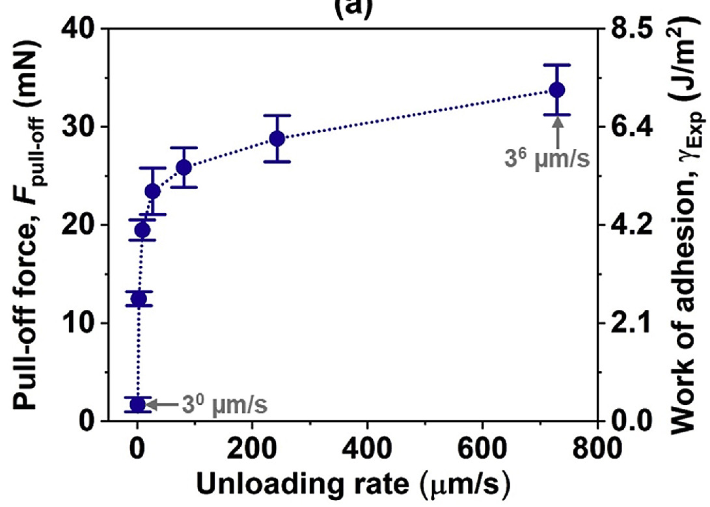
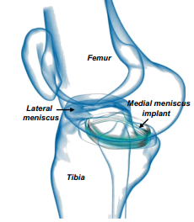
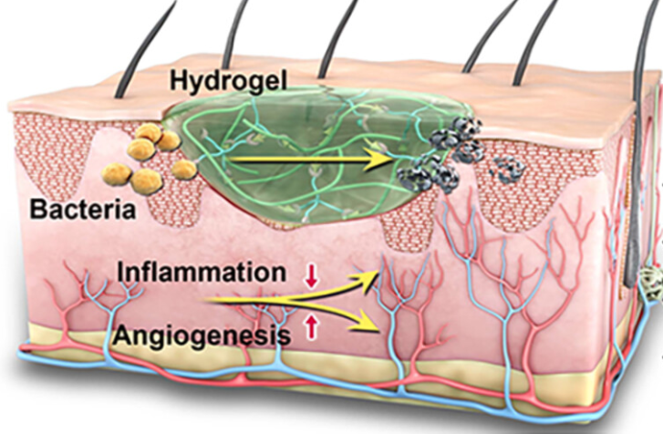
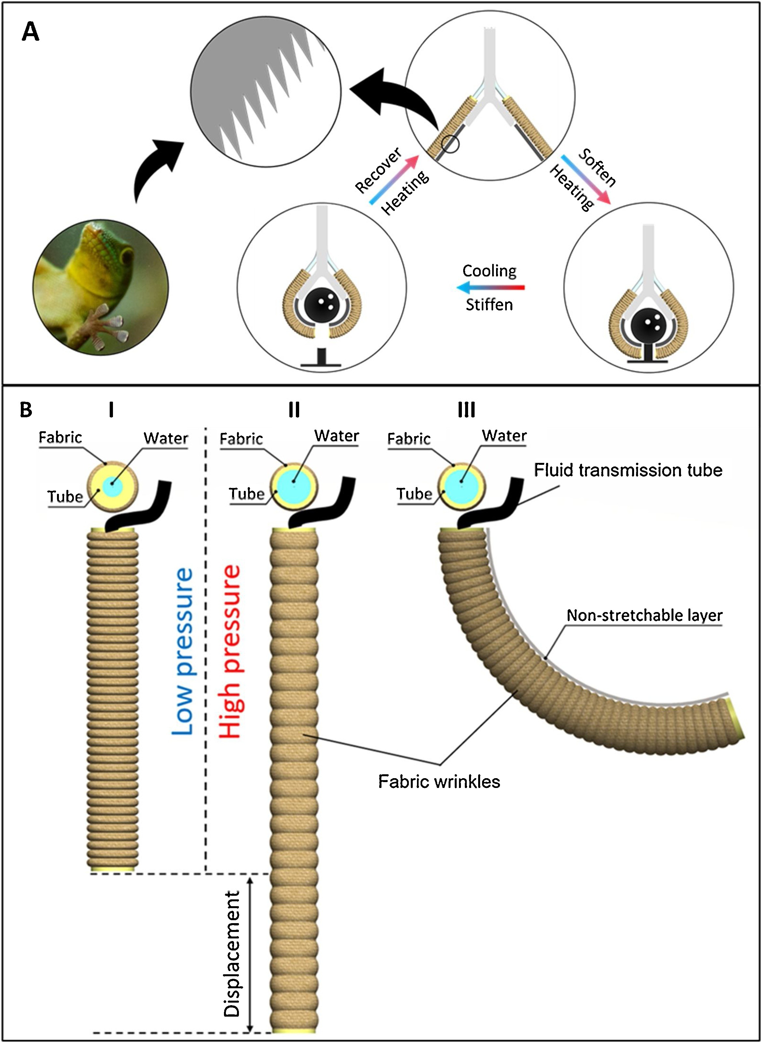
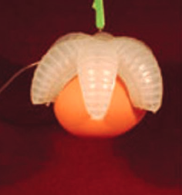
Motivation
| Motivation | Background | Theory | Validation Study | Results | Conclusion |
Soft materials like hydrogels, cartilage, and biological tissues exhibit rate-sensitive interfacial behavior.
Experimental studies show that adhesive strength, pull-off forces, and energy dissipation during adhesion change significantly with unloading rates.
To model such materials realistically, it is essential to incorporate rate effects into constitutive material model and interface constraints.
Figure: Soft-tissue implant, e.g. meniscus, design (adapted from Shemesh et al., journal of the mechanical behavior of biomedical materials, (2014)).
Figure: Adhesion response of cartilage at different unloading rate (adapted from Han et al., Journal of the mechanical behavior of biomedical materials, (2020)).
Figure: Bio-inspired soft robot-gripping (adapted from Zhou et al., Advanced Science, (2021) and Hoang et al., Sensors and Actuators A: Physical, (2021)).
Figure: Wound dressing (adapted from Shen et al., Journal of Polymer Science, (2024)).
Notes:
Soft materials—such as hydrogels, cartilage, and biological tissues, often exhibit rate-sensitive behavior. This rate-dependence is not just a material property, it also influences how interfaces behave under loading and unloading. That means their adhesion or separation response is not just a function of the load but also of how fast that load is applied or removed.
For example, the plot here shows the pull-off force and work of adhesion for cartilage increasing with the unloading rate. This kind of response has been observed in multiple experimental studies, which show that adhesive strength, pull-off forces, and energy dissipation can change significantly depending on how quickly the contact is broken.
So, if we want to model such materials realistically, especially in applications like implants, wound dressings, or soft robotic grippers, it’s essential to incorporate rate effects into both the constitutive material model and the interface constraints.

Slide 4
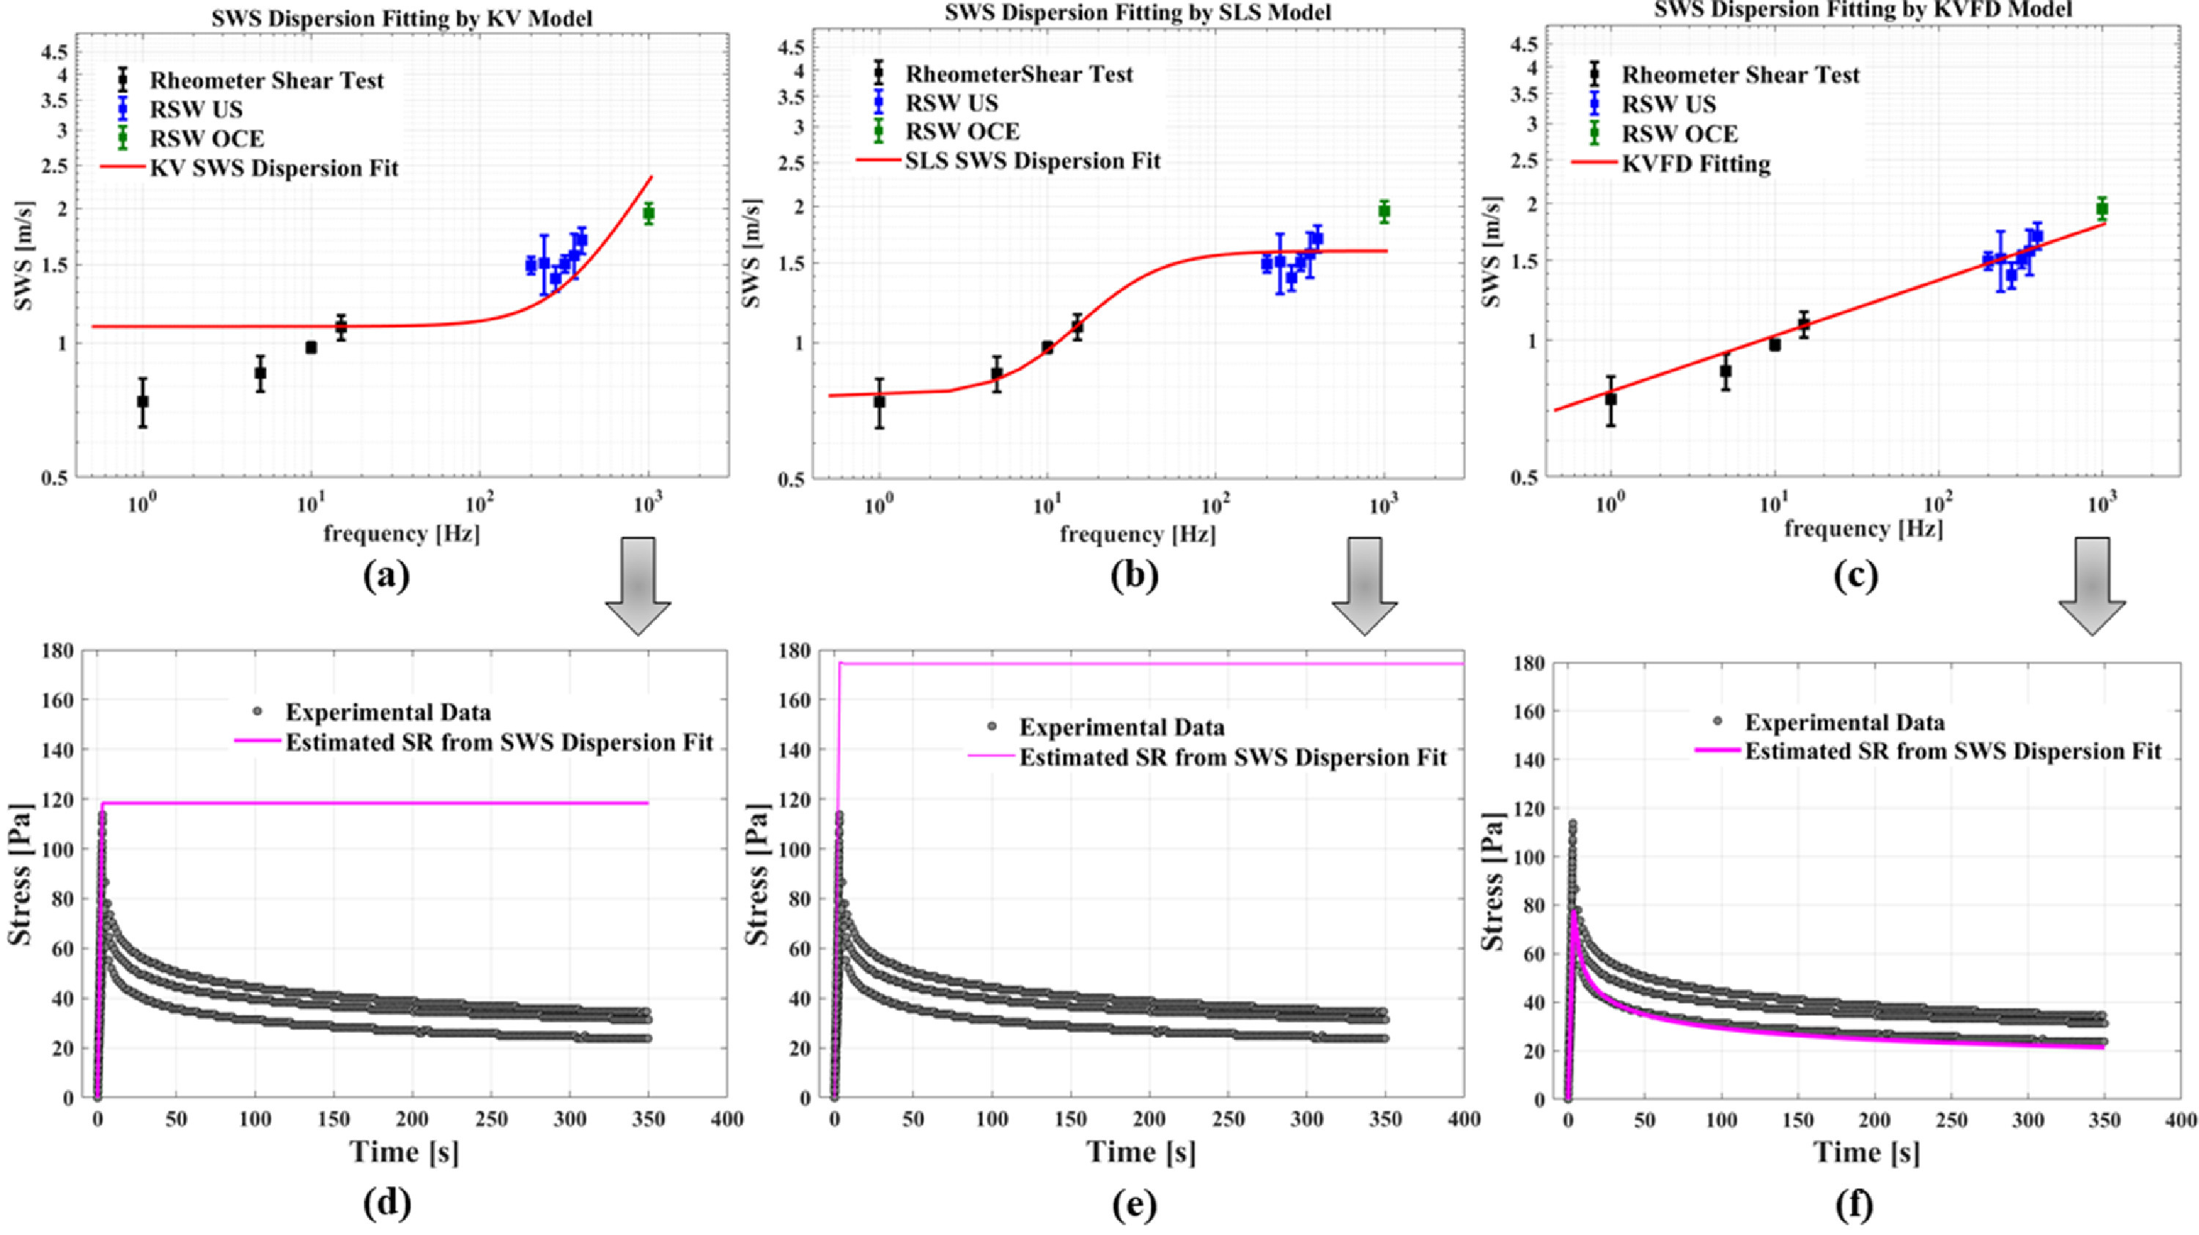
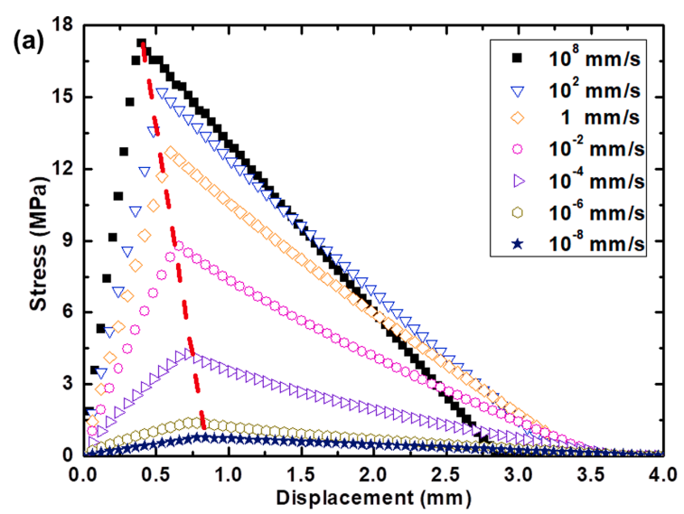
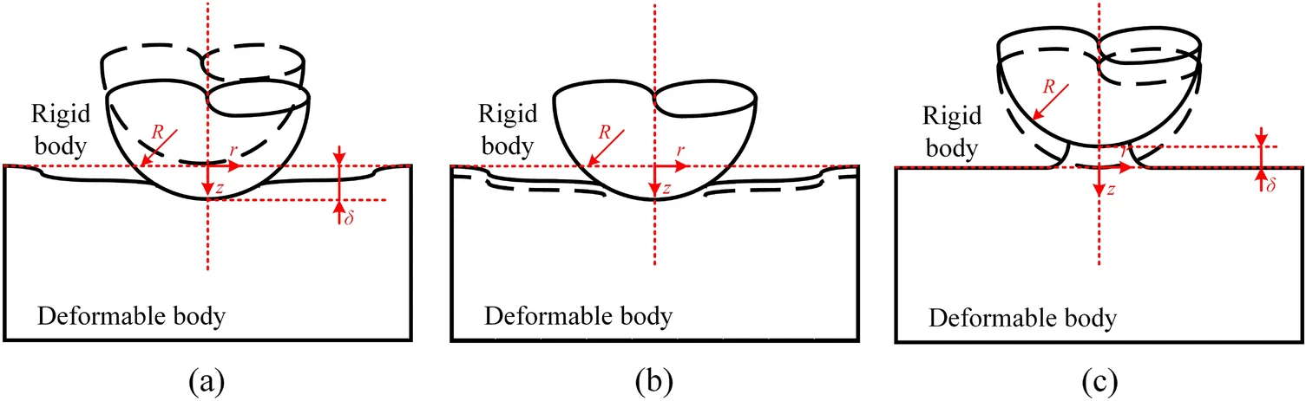
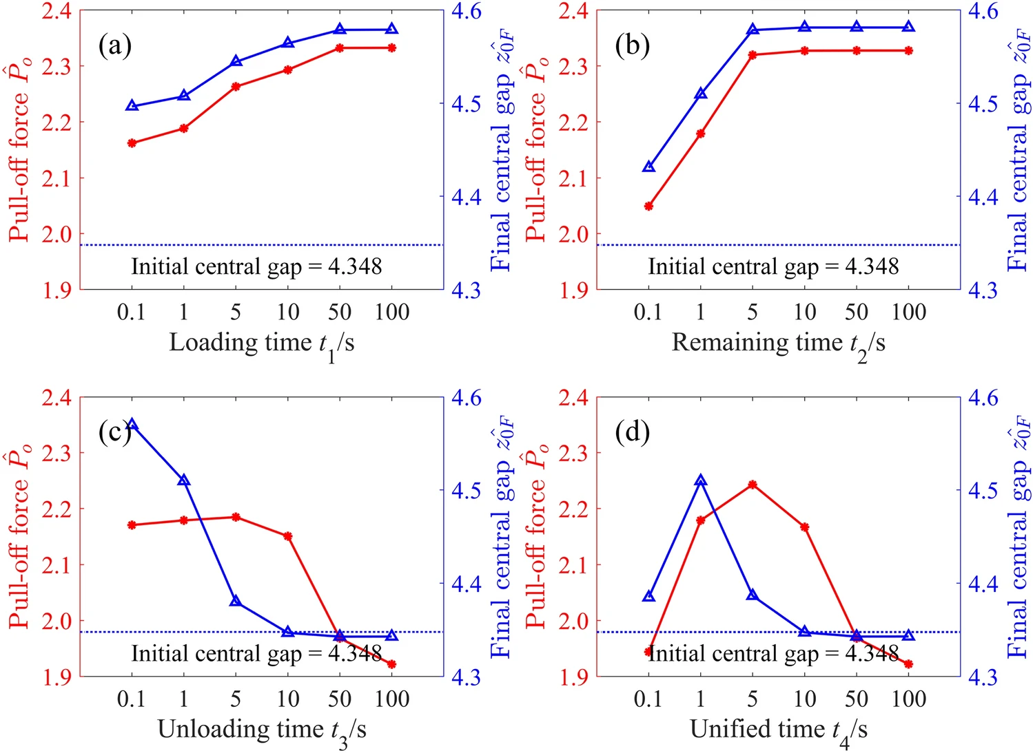
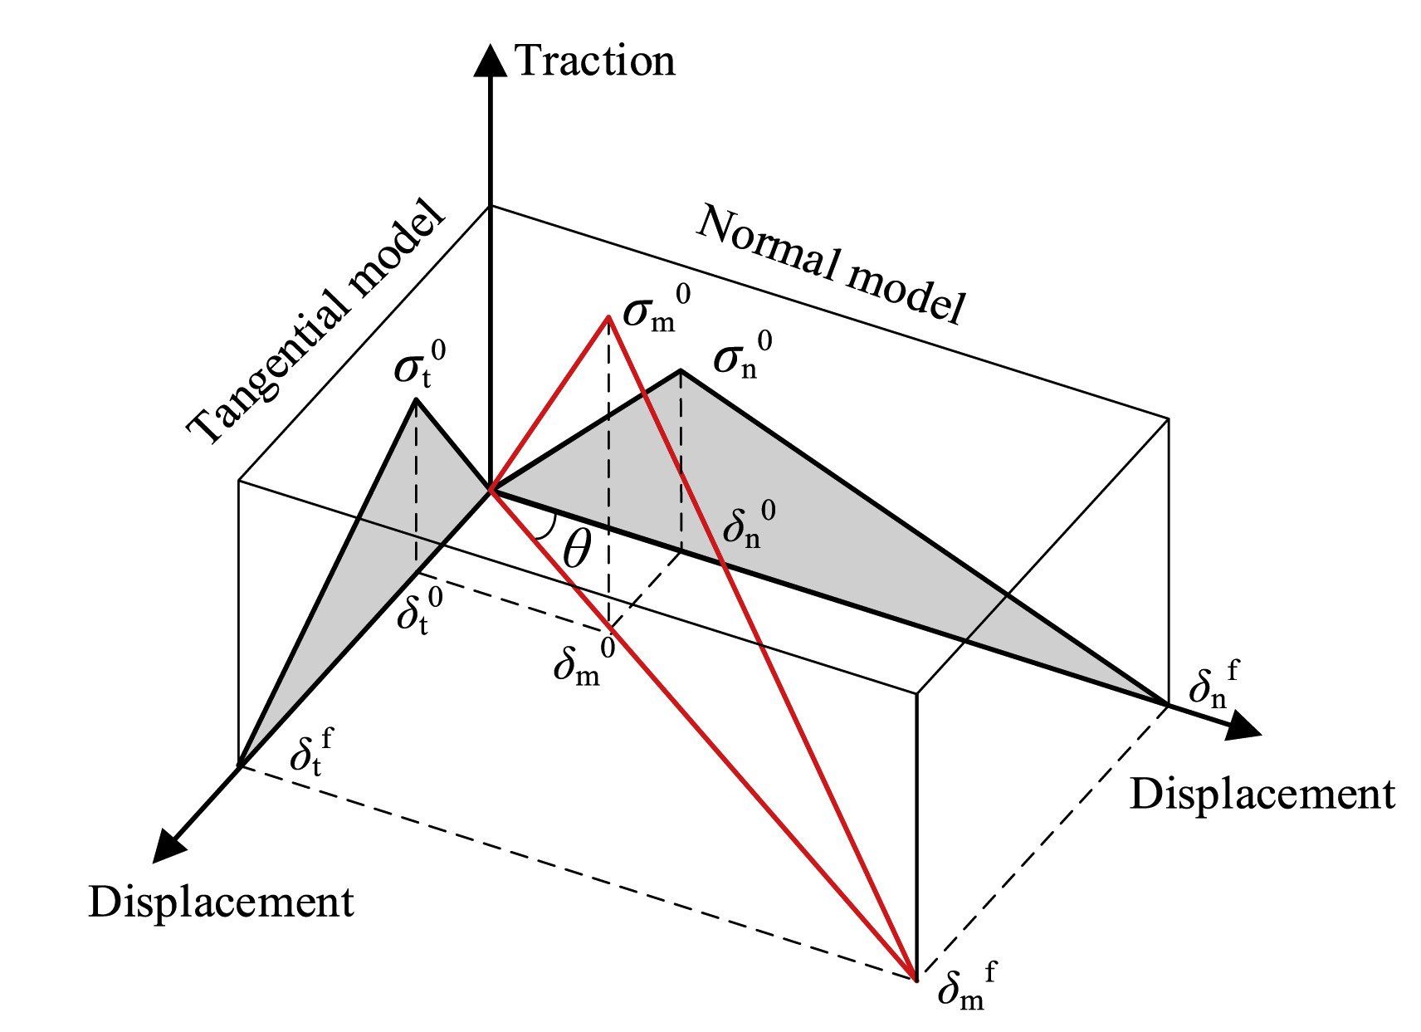
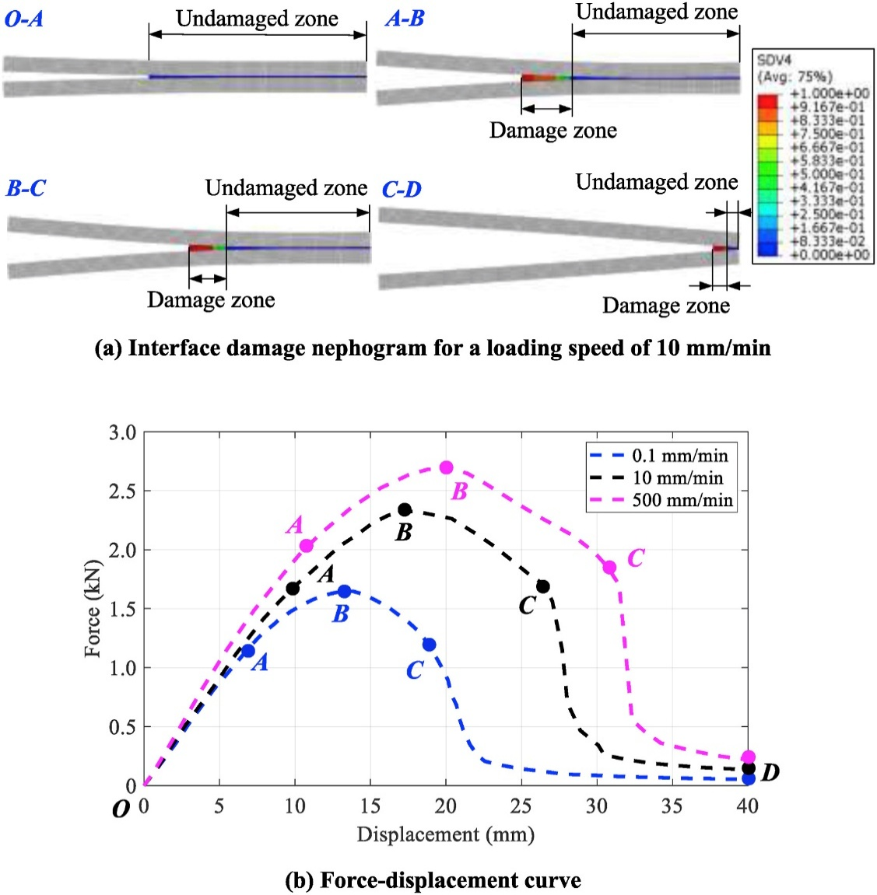
Background
| Motivation | Background | Theory | Validation Study | Results | Conclusion |
Our goal is to extend the mixed-mode bilinear cohesive zone model to include a simplified rate-dependent traction law in MOOSE that supports transient switching and uses less parameters.
Identical mechanical response of soft tissue, e.g. bovine liver, and viscoelastic material model (adapted from Poul et al., Acta biomaterialia, (2022)).
Rate-dependent bilinear CZM only applicable for mode I loading (adapted from Zhao et al., Engineering Fracture Mechanics, (2021)).
A single-cycle adhesive contact model using the Derjaguin approximation with a Lennard–Jones potential to model viscoelastic adhesion (adapted from Luo et al., Tribology Letters, (2024)) .
Rate-dependent mixed-mode bilinear CZM with B-K failure criterion solely and optimized for composite delamination (adapted from Wang et al., Ocean Engineering, (2025)).
Notes:
Now that we’ve seen why rate-dependent adhesive contact is important in soft materials, let’s take a look at some of the existing modeling approaches and where they fall short in capturing this behavior realistically.
Prior studies, like the one by Zhao et al., and Wang et al. focus on rate-sensitive interfaces assuming linear elastic bulk materials. Zhao et al. introduced a rate-dependent bilinear cohesive zone model, but it was limited to Mode I loading only—so it doesn’t capture mixed-mode behavior, which is common in soft interfaces. (Implemented as a UMAT in ABAQUS)
Wang et al’s work does extend to a mixed-mode CZM with rate effects, but it’s built specifically for composite delamination using a Benzeggagh–Kenane failure criterion, which isn’t ideal for soft biological interfaces. (Implemented in ABAQUS via VUMAT)
While these models are valuable, neither has been tested with viscoelastic bulk material, and both focus primarily on interface behavior under idealized conditions.
That brings me to the next point: soft biological materials often behave like viscoelastic solids. For example, this study on bovine liver shows that the stress-relaxation response can be captured very well with viscoelastic constitutive models. This underscores the need to go beyond purely elastic assumptions in biological contact modeling.
Building on this, Luo et al. performed a single-cycle adhesive contact simulation using a Lennard-Jones-based model combined with viscoelastic traction laws. Their approach successfully captured rate-dependent pull-off forces and interface separation behavior—but it’s limited to a single mode and not suited for transient switching between contact states.
In this work, our goal is to extend the mixed-mode bilinear cohesive zone model by including a simplified rate-dependent traction law within the MOOSE framework. This model is designed to:
Support transient switching between contact and separation,
Be parameter-efficient, and
Work realistically for soft viscoelastic interfaces, offering more flexibility than existing approaches that are tailored for purely elastic or composite systems.

Slide 5
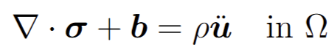
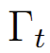
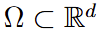
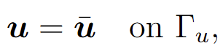
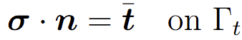
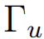
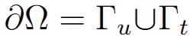
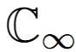
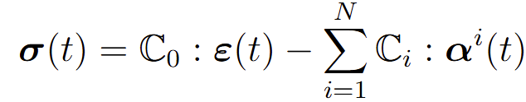
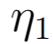
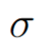
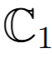
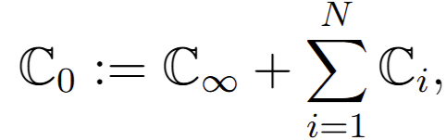
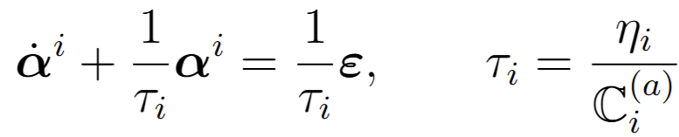
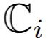
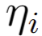
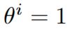
| Motivation | Background | Theory | Validation Study | Results | Conclusion |
Linear Viscoelastic Material Model
Strong forms:
Constitutive law:
Weak form:
Quasistatic
Time integration of internal variable:
where corresponds to Backward Euler integration (fully implicit).
Simo, J. C., & Hughes, T. J.. Computational inelasticity. New York, NY: Springer New York, (1998).
Notes:
This slide summarizes the small-strain linear viscoelastic material model used in this work.
Starting from the strong form of momentum balance, we assume small deformations to describe the material behavior.
The constitutive law is based on a generalized Maxwell model, where the total stress is expressed as a sum of an elastic stress response and the relaxation due to internal strains α i . The negative sign reflects that the viscous branches act to relax the stress. This model can also be visualized using a chain of spring-dashpot elements. While the material initially resists deformation with stiffness C 0​ , the viscous components reduce the stress over time. This is key to modeling rate-dependent material behavior.
Each internal strain αi evolves according to its own relaxation time τ i​ . As shown here, the evolution of α i is governed by a first-order differential equation and discretized using the θ-method—with θ=1 corresponding to backward Euler, which ensures stability for implicit time integration
The weak form here includes the contribution from the internal variables, and for quasistatic analysis, inertial terms are dropped.
To ensure this constitutive model is thermodynamically consistent, we now look at the free energy formulation

Slide 6
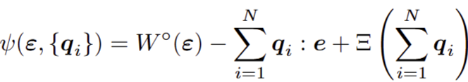
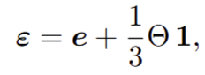
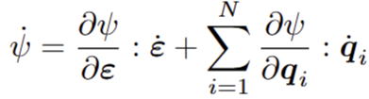
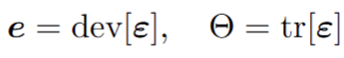
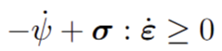
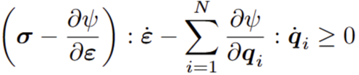
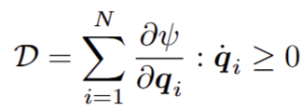
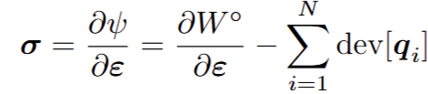
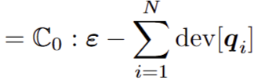
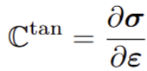
| Motivation | Background | Theory | Validation Study | Results | Conclusion |
Linear Viscoelastic Material Model (Cont’d)
The stored energy (free energy):
Clausius–Duhem inequality :
,
,
Simo, J. C., & Hughes, T. J.. Computational inelasticity. New York, NY: Springer New York, (1998).
Notes:
free energy function for the viscoelastic material depends on both the strain and internal variable.
In isothermal mechanical systems, the second law of thermodynamics reduces to the Clausius–Duhem inequality. It states that the rate of free energy storage in the material must be less than or equal to the mechanical power input. The difference corresponds to internal dissipation, which must remain non-negative to satisfy thermodynamic admissibility. Applying the Clausius–Duhem inequality, the stress and dissipation function is obtained.
The internal variables q i​ evolve in time, allowing us to capture history dependent effects that is the characteristic of a Generalized Maxwell rheology.
The consistent tangent moduli is also defined, which is necessary for achieving quadratic convergence in Newton–Raphson solution schemes..

Slide 7
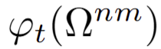
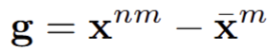
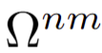
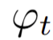
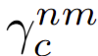
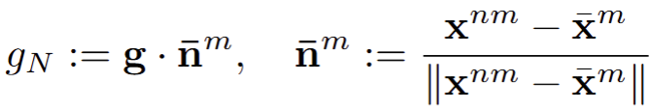
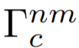
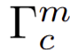
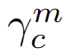
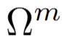
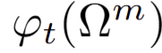
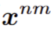






| Motivation | Background | Theory | Validation Study | Results | Conclusion |
Mortar-based Penalty Contact
Gap vector
Normal gap vector and normal vector
KKT conditions for normal contact
Penalty traction law
Fischer et al., Computational Mechanics, (2005)
Notes:
This slide outlines the formulation of mortar-based penalty contact for enforcing contact constraints between deformable bodies.
When two bodies are considered to be in contact, one body is denoted as slave or non-mortar and another is considered as mortar with their potential contact boundaries gamma.
The operator phi t describes the deformation between the reference configuration and the current configuration at time t of every point on the non-mortar body, and on the mortar body, respectively.
The gap vector g measures the relative distance (geometric gap) between a slave node x nm on the non-mortar side and its closest point projection xˉ m onto the mortar side.
The normal gap g N​ is defined by projecting the gap vector onto the contact normal n m. The normal is taken in the direction from the mortar to the non-mortar surface.
The behavior of normal contact is governed by the Karush–Kuhn–Tucker (KKT) conditions. These state that the normal gap must be non-positive, the normal contact force must be non-negative, and complementary condition needs to be satisfied.
To approximate this constraint numerically, penalty traction law is being used.
When the gap g N​ is negative, meaning penetration occurs and a compressive traction t N​ proportional to the gap is applied, scaled by a penalty parameter ε N​ . If the gap is non-negative, no traction is applied.

Slide 8



| Motivation | Background | Theory | Validation Study | Results | Conclusion |
Mortar-based Penalty Contact (Cont’)
The total potential energy
Consistent linearization of the penalty functional
Penalty contact energy functional
Variational form of the penalty functional
Fischer et al., Computational Mechanics, (2005)
Notes:
To complete the formulation, we now look at the variational structure of the penalty contact model.
The total potential energy of the system includes contributions from the internal and external work of both the mortar and non-mortar sides, along with the penalty contact energy functional, which penalizes penetration at the contact interface.
This penalty contact energy is given by the integral over the active contact boundary, where ε N​ is the penalty parameter and g N​ is the normal gap.
Taking the first variation of this functional gives us the weak form of the contact contribution. The first term contributes to the contact force residual, and the second arises due to changes in the surface measure under deformation.
On the right, the consistent linearization of this variation is showed. Each term in the tangent matrix comes from linearizing either δg N​ , the gap variation, or δ(da), the change in area under deformation.
This consistent tangent ensures quadratic convergence in Newton–Raphson iterations and is essential for the stability of large deformation contact simulations.”

Slide 9













| Motivation | Background | Theory | Validation Study | Results | Conclusion |
Bilinear Mixed Mode CZM
Total mixed-mode relative displacement and mixity ratio
traction
,
Normal mode
Mixed mode softening onset
Tangential mode
displacement
Failure Prediction
displacement
Failure Criterion
Power Law
BK Law
Camanho et al., (No. NAS 1.15: 211737, (2002)
Notes:
Now that we’ve introduced the contact formulation, let’s move into the cohesive zone modeling, specifically for mixed-mode adhesion.
In a mixed-mode CZM, the separation is characterized not just by a normal gap, but also by tangential displacements. So, we define the total mixed-mode relative displacement, 𝛿𝑚δ m​ , which combines normal and tangential contributions. The mixity ratio, β, helps track whether the separation is predominantly normal or tangential.
Damage initiates when δ m​ reaches the softening threshold δ m0​ , and this onset depends on both the normal and tangential thresholds through the equation shown here. This formulation ensures that the interface softens progressively, even under mixed loading conditions.
Two common failure criteria used are the Power Law and the Benzeggagh–Kenane (B-K) Law. These are used to define the final separation δ mf​ at which complete decohesion occurs. The Power Law provides a smooth failure envelope, while the B-K law offers more control over the energy partitioning between Mode I and Mode II.”

Slide 10




| Motivation | Background | Theory | Validation Study | Results | Conclusion |
Rate-dependent Bilinear Mixed Mode CZM
Damage
Viscous regularization
Rate-dependent traction
Total traction
Variational form
Yu et al., Engineering Fracture Mechanics, (2016)
Notes:
The baseline for our rate-dependent formulation is formed by rate-independent cohesive zone model.
As the total mixed-mode separation δ m​ increases from its onset value δ m0​ to the final separation δ mf​ , the damage variable D increases from 0 to 1.
Once D reaches 1, the interface is fully debonded.
The traction-separation law consists of two parts:
• The active (tensile) direction, which is responsible for driving damage, and
• The inactive direction, which remains elastic but does not contribute to degradation.
This ensures that compression or frictional effects don’t incorrectly trigger damage.
Now, to capture rate effects seen in soft materials, we introduce a viscous term to this model inspired from literature.
The rate-dependent formulation modifies the traction by adding a term proportional to the separation rate in the active direction.
This means the faster the interface opens, the higher the resistance—mimicking viscous adhesion observed in biological tissues and hydrogels.
To avoid instability from abrupt damage jumps, we also apply viscous regularization to the damage variable itself. This smooths its evolution across time steps, especially when the opening rate suddenly changes.
Finally, all of this is incorporated consistently into the weak form via the cohesive virtual work expression shown at the bottom.

Slide 11











| Motivation | Background | Theory | Validation Study | Results | Conclusion |
Validation of Generalized Maxwell Model
A 3D viscoelastic block subjected to a step displacement is simulated using MOOSE to compare its time-dependent stress response with the analytical solution.
u_{y}
u_{y}
u_{y}
u_{y}
1 m
1 m
Analytical solution:
1 m
Material property:
Jalocha et al., International Journal of Solids and Structures, (2015)
Notes:
Before moving to more complex contact and adhesion simulations, I first verified that the built-in Generalized Maxwell model in MOOSE behaves as expected.
For this, I set up a simple benchmark: a 3D viscoelastic block subjected to a step displacement. The bottom face is fixed, and the top face is displaced downward and held constant—generating a uniaxial strain state.
The stress response is governed by a standard Generalized Maxwell model, shown here schematically, consisting of an elastic spring E ∞​ in parallel with two Maxwell elements. The analytical solution for the stress relaxation is a sum of exponential decays, and it’s provided at the bottom left.

Slide 12


| Motivation | Background | Theory | Validation Study | Results | Conclusion |
Validation of Generalized Maxwell Model (Cont’)
Time = 0.1 sec
Time = 100 sec
Notes:
The plot in the center shows the stress decay under constant strain. The solid black curve is the analytical solution, and the red dashed line is the MOOSE simulation result. As you can see, they’re nearly indistinguishable, indicating excellent agreement.
To the left, I’ve plotted the relative error over time. The maximum error stays below 2%, and it gradually decreases as the stress relaxes, which is expected as the numerical model reaches equilibrium.
On the right, I’ve visualized the stress distribution at two different time points.
• At 0.1 seconds, the stress is still near the initial peak value.
• At 100 seconds, the stress has relaxed significantly.
These results confirm that MOOSE accurately captures the time-dependent response of viscoelastic materials governed by the Generalized Maxwell model. This gives confidence that the model behaves as expected and can now be extended to contact and adhesion problems.

Slide 13


| Motivation | Background | Theory | Validation Study | Results | Conclusion |
Rate-dependent Material Response
Compression
Notes:
we investigate how the material responds under different loading rates.
On the left, you can see the prescribed displacement history for four loading rates: 50, 1, 0.5, and 0.17 mm/s. All cases apply the same total displacement, but over different durations. Once the full strain is applied, it’s held constant to observe stress relaxation.
On the right, the plot shows how the stress evolves over time for each case.As expected:Faster loading rates produce higher peak stresses,Slower loading allows time for the material to relax, resulting in lower peaks,But in all cases, the stress eventually converges to the same long-term equilibrium value.
This clearly demonstrates that the model captures strain-rate sensitivity —a key feature of viscoelasticity that is especially relevant when modeling soft tissues or hydrogels under varying deformation speeds.”

Slide 14







| Motivation | Background | Theory | Validation Study | Results | Conclusion |
Validation of Contact
Hertzian Contact Solution:
Contact pressure p₀ and contact radius a are predicted using Hertzian theory for a deformable sphere-flat configuration.
The 2D plane-strain contact simulation is performed in MOOSE and ABAQUS.
The analytical values are used to validate accuracy of the simulated contact pressure distribution and contact area.
Material property:
Johnson, K. L. (1987). Contact mechanics. Cambridge university press.
Notes:
Before I move into the core part of my work, I’d like to briefly show a validation study I performed using the existing penalty mortar contact formulation in MOOSE.
Here, I set up a Hertzian contact problem—a deformable sphere in contact with a flat substrate. The analytical solution for this setup, based on Hertz theory, allows us to predict the contact pressure and contact radius.
The material properties and setup are taken directly from the classical formulation, and the goal here is to verify that the existing contact implementation in MOOSE reproduces those results accurately.

Slide 15






| Motivation | Background | Theory | Validation Study | Results | Conclusion |
Validation of Contact (Cont’d)
MOOSE Result:
MOOSE
6.6 % error in Contact radius
3.3 % error in Contact pressure
Analytical:
Notes:
On the left, you can see how I computed the contact radius and peak pressure from the MOOSE simulation. These values are compared against the Hertzian solution shown at the bottom.
The MOOSE results match the analytical values closely, with only 6.6% error in contact radius and 3.3% error in pressure.
The plot on the right shows the contact pressure distribution along the surface. As you can see, the simulation closely follows the analytical shape, confirming that the contact formulation is working as expected.”

Slide 16


| Motivation | Background | Theory | Validation Study | Results | Conclusion |
Validation of Contact (Cont’d)
Last timestep
(mm)
(MPa)
Notes:
The left plot displays the vertical displacement field, and the right shows the 𝜎𝑦𝑦σ yy​ stress field. The stress is highest right beneath the indenter, which is consistent with what we expect from Hertzian theory.
This validation was important for me to build confidence in using MOOSE for my contact simulations. However, I want to emphasize that I have not modified the contact model—this result simply ensures that I can reproduce known contact mechanics behavior correctly before incorporating rate-dependent adhesion, which is the main focus of my work.”

Slide 17





| Motivation | Background | Theory | Validation Study | Results | Conclusion |
Validation of Adhesion
JKR Solution:
The pull-off force per unit length, F_{p}, is predicted using the JKR theory under a two-dimensional plane strain assumption.
The simulation is performed in MOOSE using a rate-independent cohesive zone model.
The JKR approximation is found to overestimate the pull-off force per unit length.
50 mm
E₁, υ₁
E₂, υ₂
200 mm
200 mm
Chen et al., Journal of colloid and interface science, (2006)
Notes:
Now I’ll move to validating the adhesion model that I implemented in MOOSE by modifying the cohesive zone formulation to include rate-dependent effects.
To test whether the implementation behaves correctly, I first set the traction viscosity to zero, effectively reducing the model to its rate-independent limit.
This step allows me to validate the formulation against the well-known JKR solution, which provides an analytical prediction of pull-off force under a 2D plane strain assumption.
The analytical pull-off force per unit length is approximately 2655.86 N/mm.
In my simulation, I applied cohesive traction between a sphere and a flat substrate and monitored the pull-off force.

Slide 18










| Motivation | Background | Theory | Validation Study | Results | Conclusion |
Validation of Adhesion (Cont’d)
@ 0.14 sec
(mm)
(MPa)
1 2 3 4
Time = 0.14 sec
Notes:
At around 0.14 seconds, the simulation records a peak total pull-off force of approximately 3548 N, which I extracted from MOOSE using Side reaction post processor at the interface.
To compare this with the JKR analytical solution, which gives force per unit length, I needed to calculate the equivalent force per unit length from my simulation.
So, I identified the number of elements along the contact interface that contributed significantly to the adhesive stresses, and multiplied that count by the element edge length to get an effective contact width.
Dividing the total pull-off force by this width gave me approximately 1971.38 N/mm, leading to a 25.77% error compared to the analytical JKR value.
This step was essential for making a fair comparison between the 2D simulation and the plane strain-based JKR theory, and it helps validate that the implementation behaves correctly in the rate-independent limit.

Slide 19


| Motivation | Background | Theory | Validation Study | Results | Conclusion |
Adhesion Analysis Between Viscoelastic and Elastic Material
displacement
Two-dimensional plane strain configuration with a cubic elastic indenter and viscoelastic substrate.
Adhesion modeled using a rate-dependent cohesive zone model integrated with mortar-based contact constraints.
Pull-off force examined under different unloading rate.
1 mm
Material property:
Top block (Elastic):
Bottom block (Viscoelastic):
1 mm
Cohesive Zone Material property (traction viscosity = 100):
1 mm
Notes:
Now I’ll walk you through the main simulation setup used to test our rate-dependent adhesion implementation.
We consider a 2D plane strain configuration, where a cubic elastic indenter is brought into contact with a viscoelastic substrate.
The adhesion is modeled using a rate-dependent cohesive zone model integrated with mortar-based contact constraints.
This setup allows us to examine the pull-off behavior under different unloading rates.
On the left, I’ve listed the material properties for the elastic indenter, viscoelastic substrate, and cohesive zone. Notably, for this study, I use a traction viscosity value of 100 MPa·s/mm in the cohesive zone model."

Slide 20


| Motivation | Background | Theory | Validation Study | Results | Conclusion |
Rate-independent Adhesion Response
Maximum applied unloading displacement 0.27 mm
Notes:
Here, I show the rate-independent case, where traction viscosity is set to zero.
On the left, you see the displacement histories for six different unloading rates ranging from 0.01 mm/s to 4 mm/s.
On the right, we observe the force-displacement responses for those same unloading rates. As expected in a rate-independent formulation, the curves collapse onto each other during unloading. This demonstrates that the current implementation behaves consistently when no rate sensitivity is introduced.

Slide 21



| Motivation | Background | Theory | Validation Study | Results | Conclusion |
Rate-dependent Adhesion Response
Notes:
Here we can see the effect of unloading rate on the adhesion response when traction viscosity is active in the cohesive zone model.
On the left, we plot the force vs. displacement curve for various unloading rates ranging from 0.01 mm/s to 4 mm/s. The inset zoom highlights the region around the peak force, or pull-off point. We observe a clear trend: as the unloading rate increases, the pull-off force also increases. This rate dependence is a hallmark of viscoelastic adhesion and confirms that the model captures this behavior accurately.
On the right, we have the traction vs. displacement jump plots. Again, you can see that higher unloading rates lead to higher peak tractions, followed by a more rapid softening response.
Together, these plots validate that the cohesive zone model successfully captures the rate-sensitive nature of soft material adhesion.

Slide 22


| Motivation | Background | Theory | Validation Study | Results | Conclusion |
Effect of Traction Viscosity [unloading rate 4mm/sec]
Notes:
Now let’s look at the effect of the traction viscosity parameter at a fixed unloading rate of 4 mm/s.
On the left, we have the force-displacement response for several values of traction viscosity, ranging from 0 to 10,000 MPa·s/mm. While all cases follow similar loading paths, differences emerge at the peak force and during unloading.
The zoomed-in plot on the right highlights this. As the traction viscosity increases, the pull-off force increases. This shows that the viscous resistance in the cohesive zone effectively delays damage evolution, leading to higher adhesion.
In particular, the case with 10,000 MPa·s/mm shows a noticeable increase in peak force compared to the lower viscosity cases. This confirms that traction viscosity plays a strong role in controlling rate-dependent adhesion behavior.

Slide 23


| Motivation | Background | Theory | Validation Study | Results | Conclusion |
Effect of Traction Viscosity [unloading rate 1mm/sec]
Notes:
I also examined the effect of traction viscosity at a slower unloading rate of 1 mm/s. The trends are consistent: as the viscosity increases, the pull-off force increases—though the change is more modest than at higher rates.
This confirms that the traction viscosity in the cohesive zone influences adhesion in a rate-sensitive manner, even when the overall loading is slower.

Slide 24


| Motivation | Background | Theory | Validation Study | Results | Conclusion |
Adhesion Analysis Between Gelatin and Glass
Lee et al., Soft Matter, (2024)
Force Vs. Time
1 mm/s
0.5 mm/s
0.1 mm/s
Notes:
This slide shows the adhesion analysis between a gelatin substrate and a glass indenter, using material properties taken from Lee et al., 2024 which also shows consistent rate-dependent behavior.
As we decrease the unloading rate, the peak pull-off displacement increases, and pull-off force decreases.

Slide 25


| Motivation | Background | Theory | Validation Study | Results | Conclusion |
Conclusion
Rate-independent mixed-mode adhesion models fall short in capturing the time-dependent physical behavior observed in soft adhesive contact.
Through validation studies, critical insight has been gained into the mechanics of viscoelastic bulk response, contact enforcement, and adhesive separation.
The rate-dependent adhesion model successfully captures key experimental trends, especially the increase in pull-off force with unloading rate that demonstrates the importance of incorporating rate effects into cohesive zone formulations. .
The traction viscosity greatly influences adhesive strength of soft material.
Notes:
First, we found that rate-independent mixed-mode adhesion models fall short in capturing the time-dependent physical behavior seen in soft adhesive contact — especially when viscoelastic materials are involved.
Through a series of validation studies, we gained important insight into the mechanics of the viscoelastic bulk material, the contact enforcement via mortar methods, and how adhesion evolves and separates over time.
Most importantly, the rate-dependent cohesive zone model that I implemented was able to successfully reproduce experimental trends — particularly the increase in pull-off force with faster unloading rates. This emphasizes how critical it is to include rate effects in cohesive formulations when modeling realistic adhesive behavior.
Lastly, we observed that the traction viscosity parameter significantly influences the peak adhesive force, especially for viscoelastic substrates — suggesting it's a key lever for tuning adhesion strength in design or material calibration.”

Slide 26

Acknowledgement
The authors would like to thank the National Science Foundation for supporting this research (Award No.: 2224371, CMMI-Div Of Civil, Mechanical, & Manufact Inn, Program Director: Lucy T. Zhang)
Notes:
I would like to acknowledge the support of the National Science Foundation for this research. under Award Number 2224371, through the CMMI Division of Civil, Mechanical, and Manufacturing Innovation. Special thanks to Program Director Dr. Lucy T. Zhang for her guidance and support.

Slide 27
References
Han, G., Eriten, M., & Henak, C. R. (2020). Rate-dependent adhesion of cartilage and its relation to relaxation mechanisms. Journal of the mechanical behavior of biomedical materials, 102, 103493.
Shen, Y., Zhang, Z., Chen, X., & He, C. (2024). Tissue‐adhesive, antibacterial, naturally‐derived polymer hydrogels as wound dressings for infected and chronic wound healing. Journal of Polymer Science, 62(11), 2320-2339.
Shemesh, M., Asher, R., Zylberberg, E., Guilak, F., Linder-Ganz, E., & Elsner, J. J. (2014). Viscoelastic properties of a synthetic meniscus implant. journal of the mechanical behavior of biomedical materials, 29, 42-55.
Zhou, L., Ren, L., Chen, Y., Niu, S., Han, Z., & Ren, L. (2021). Bio‐inspired soft grippers based on impactive gripping. Advanced Science, 8(9), 2002017.
Hoang, T. T., Quek, J. J. S., Thai, M. T., Phan, P. T., Lovell, N. H., & Do, T. N. (2021). Soft robotic fabric gripper with gecko adhesion and variable stiffness. Sensors and Actuators A: Physical, 323, 112673.
Poul, S. S., Ormachea, J., Gary, R. G., & Parker, K. J. (2022). Comprehensive experimental assessments of rheological models’ performance in elastography of soft tissues. Acta biomaterialia, 146, 259-273.
Zhao, G., Xu, J., Feng, Y., Tang, J., Chen, Y., Xin, S., ... & Xu, J. (2021). A rate-dependent cohesive zone model with the effects of interfacial viscoelasticity and progressive damage. Engineering Fracture Mechanics, 248, 107695.
Wang, Q., Zhang, Y., Vaz, M. A., Liu, D., & Cao, T. (2025). Research on interface viscoelastic mechanical model based on modified cohesive zone and generalized Maxwell models. Ocean Engineering, 332, 121381.
Violano, G., Chateauminois, A., & Afferrante, L. (2021). A JKR-like solution for viscoelastic adhesive contacts. Frontiers in Mechanical Engineering, 7, 664486.
Notes:
Here are the key references that have informed and supported this work.

Slide 28
References
Luo, J., Liu, J., Xia, H., Ao, X., Fu, Z., Ni, J., & Huang, H. (2024). Finite element analysis of adhesive contact behaviors in elastoplastic and viscoelastic media. Tribology Letters, 72(1), 7.
Simo, J. C., & Hughes, T. J. (1998). Computational inelasticity. New York, NY: Springer New York.
Fischer, K. A., & Wriggers, P. (2005). Frictionless 2D contact formulations for finite deformations based on the mortar method. Computational Mechanics, 36(3), 226-244.
Camanho, P. P., & Dávila, C. G. (2002). Mixed-mode decohesion finite elements for the simulation of delamination in composite materials (No. NAS 1.15: 211737).
Yu, H., Olsen, J. S., Olden, V., Alvaro, A., He, J., & Zhang, Z. (2016). Viscous regularization for cohesive zone modeling under constant displacement: An application to hydrogen embrittlement simulation. Engineering Fracture Mechanics, 166, 23-42.
Jalocha, D., Constantinescu, A., & Neviere, R. (2015). Revisiting the identification of generalized Maxwell models from experimental results. International Journal of Solids and Structures, 67, 169-181.
Johnson, K. L. (1987). Contact mechanics. Cambridge university press.
Chen, S., & Wang, T. (2006). General solution to two-dimensional nonslipping JKR model with a pulling force in an arbitrary direction. Journal of colloid and interface science, 302(1), 363-369.
Lee, W., & Eriten, M. (2024). Poroviscoelastic relaxations and rate-dependent adhesion in gelatin. Soft Matter, 20(23), 4583-4590.
Notes:
That concludes my presentation.
I’d like to sincerely thank you all for your attention and interest. Special thanks to Professor Truster for his guidance.
I’d be happy to take any questions.

